Slide 1
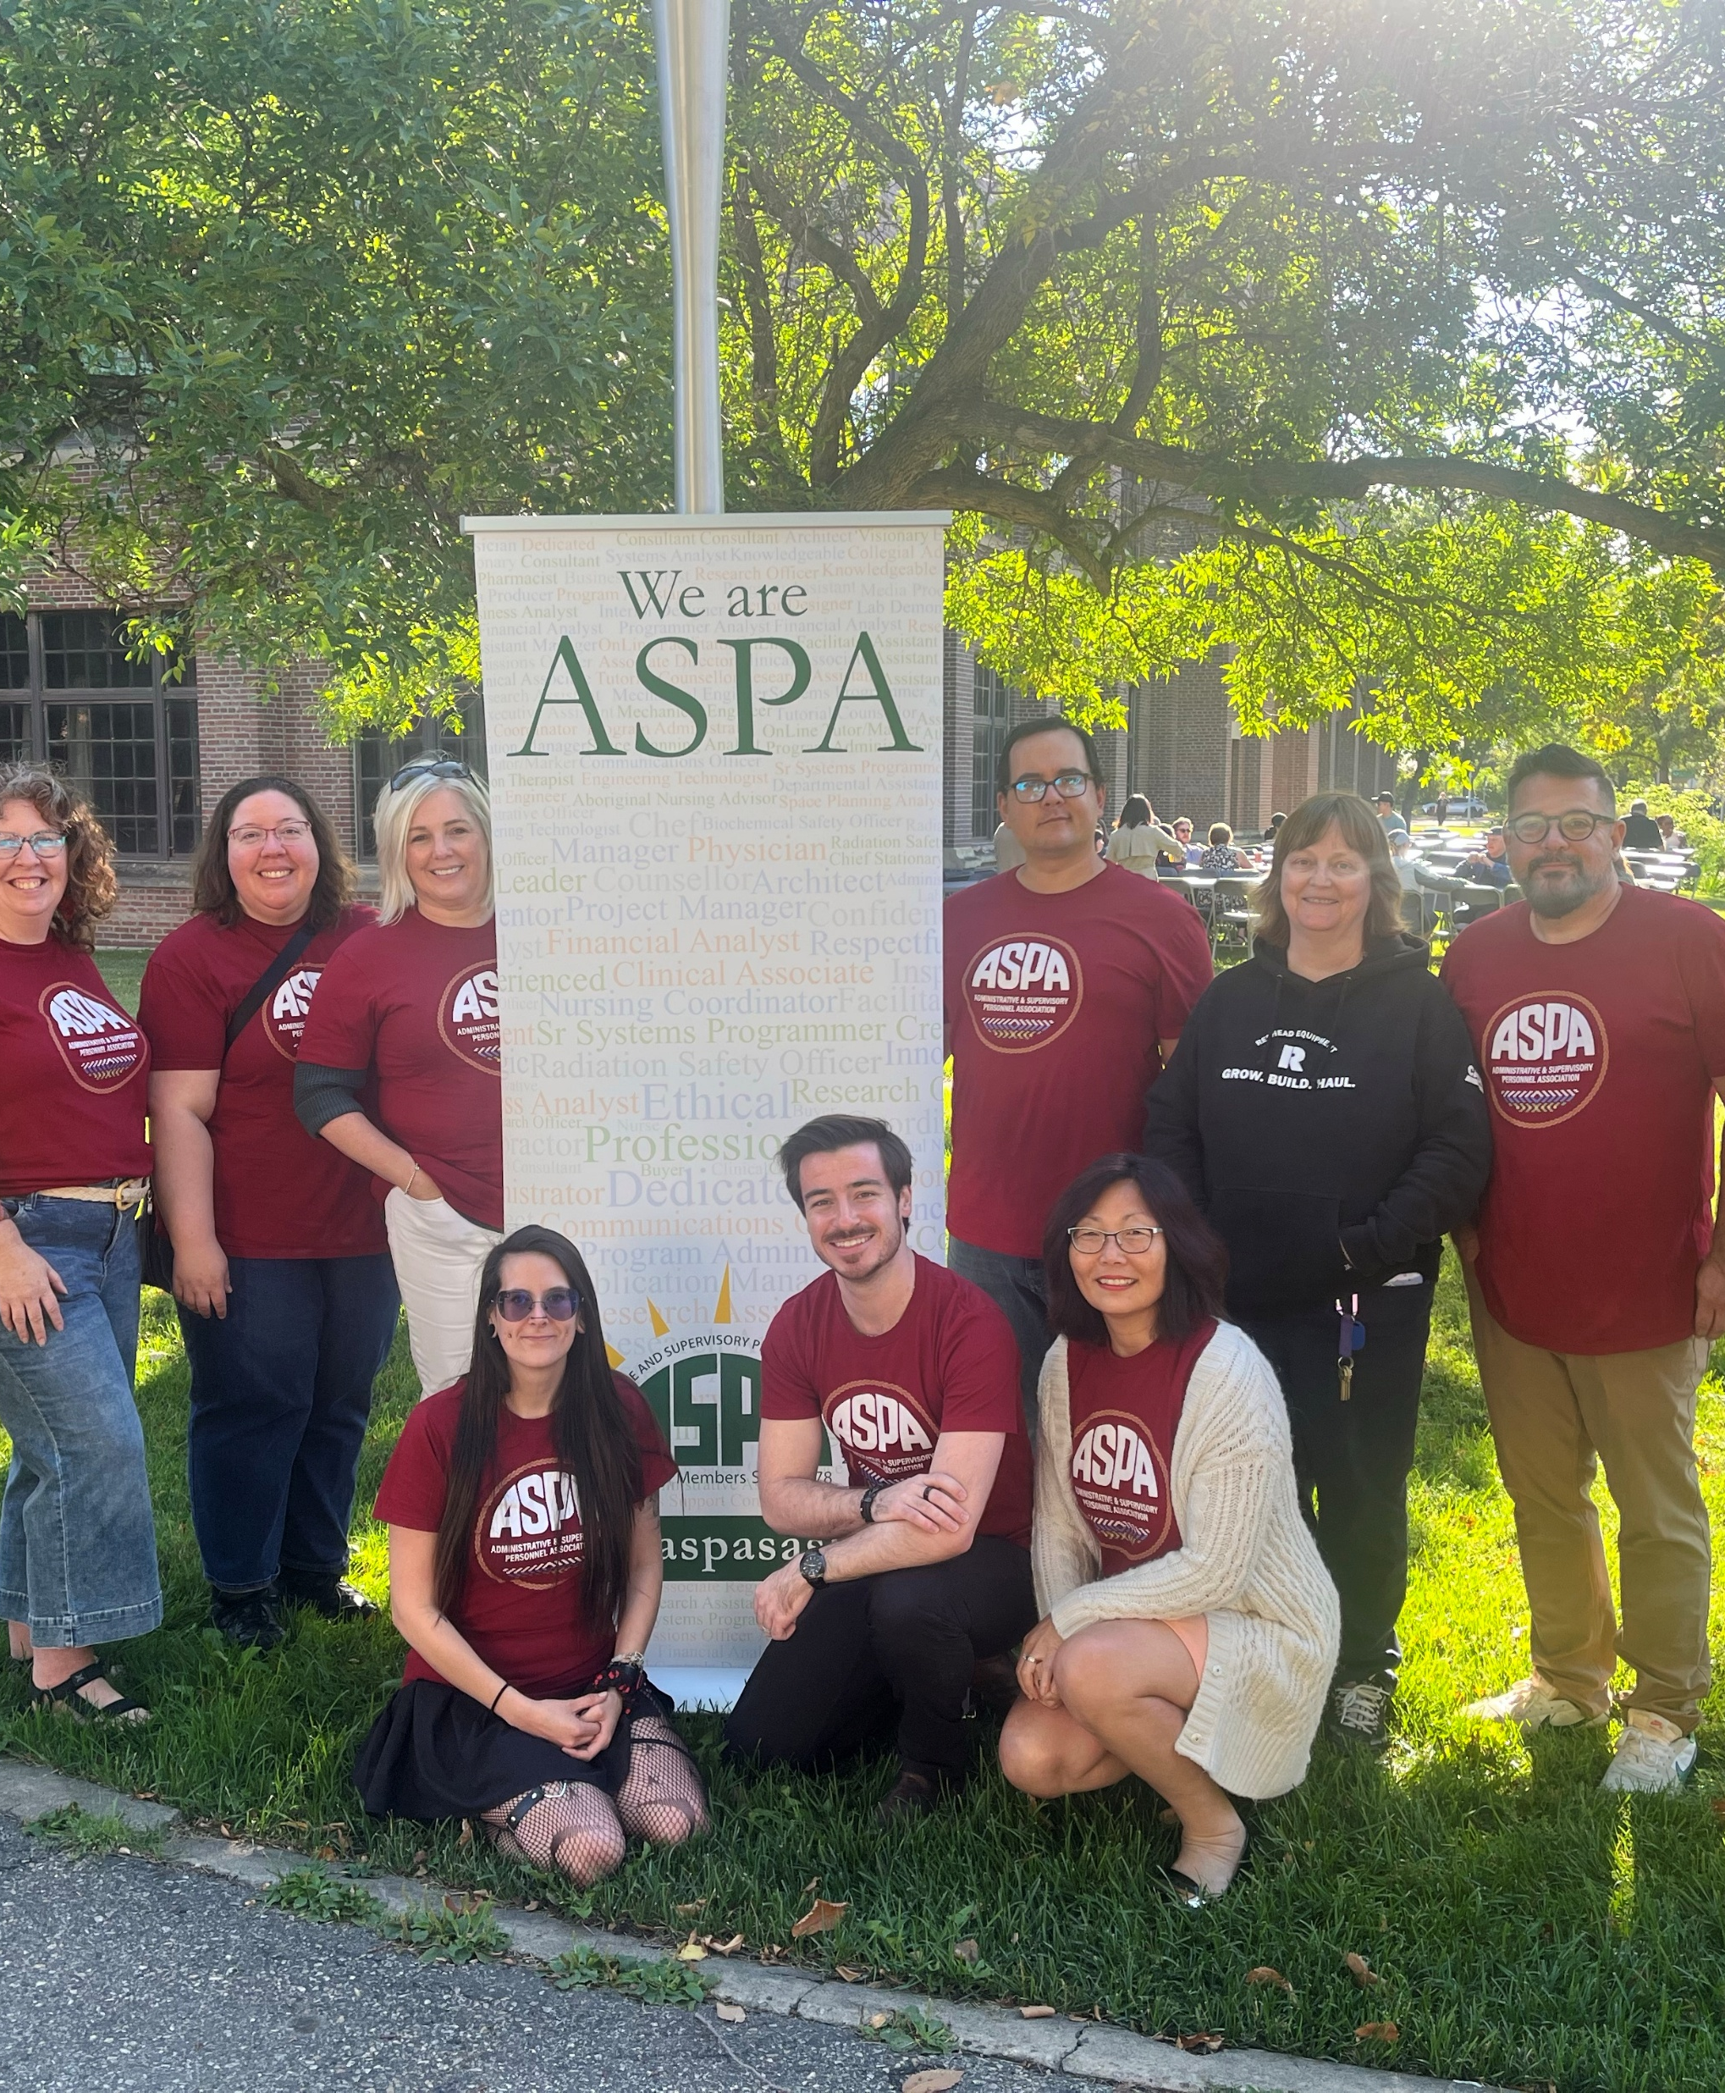


Lunch and Learn
What does an ASPA Executive do?
September 22, 2026
Presented by Darla Read

Slide 2
Land Acknowledgement
ASPA represents members who work in Treaty Six and Treaty Four territories, and we acknowledge the significance of the lands on which our members work. These are the traditional lands of Indigenous peoples including the Cree, Dene, Nakota, Saulteaux, Ojibwe, Lakota, and Dakota nations, as well as homeland of the Métis Nation.
We recognize and honor that these lands have sustained these peoples since time immemorial, and that today the land on which we work remains fundamental to our livelihoods.
In honoring the land and its Indigenous caretakers, we strive to create workplaces where all workers are treated with dignity and respect, and where the values of reconciliation and solidarity are upheld.

Slide 3
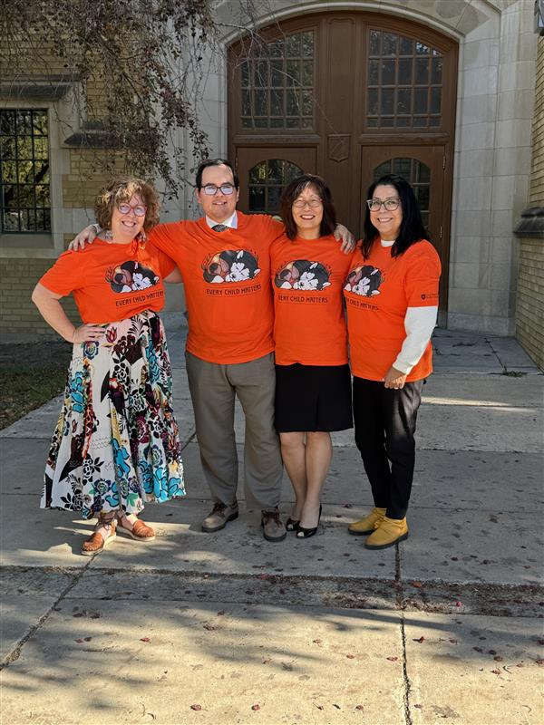
AGENDA
ASPA Overview
Work of the ASPA Executive
ASPA Standing Committees
Other Committees
Benefits of becoming an Executive member
Nomination and election process
Q&A

Slide 4
ASPA OVERVIEW
Who is ASPA?
ASPA (Administrative and Supervisory Personnel Association) is a trade union certified in 1978 following a decision of the Supreme Court of Canada. ASPA is largely a volunteer-run organization.
Members are knowledge workers, performing independent, non – routine tasks, supervisory duties, research and instructional activities, holistic analysis, and tasks beyond those that follow established policies and procedures.
Members have responsibility for decisions that have an impact across a unit, division, and/or extend over a significant period of time.
Members have diverse skill sets that may be unique to their unit or department.
Members work in diverse settings across the Saskatoon, Prince Albert, and Regina campuses (and beyond).
Current membership is over 1600.
Notes:
It's the middle manager professional people: the vet, the accountant, the communicator

Slide 5

ASPA’s Vision
To effectively represent its members and be a positive agent for progress at the University of Saskatchewan.

Slide 6
How is ASPA’s vision accomplished?
Serving as a collective bargaining agent for our members.
Promoting member interests in negotiations with the employer, and through various USask and inter-union interactions.
Maintaining communications with the USask Board of Governors (or their representatives) with respect to work conditions for members.
Developing and promoting educational and professional programs for our members.
Providing improved communications among members and with other segments of the USask community.
Notes:
Normally when you are employed, you have an individual contract with the employer. In a union, you have a collective agreement, so your relationship with the employer is through the union. We negotiate the CBA and negotiate with union representatives for all other aspects and provide communication and PD as we can.

Slide 7
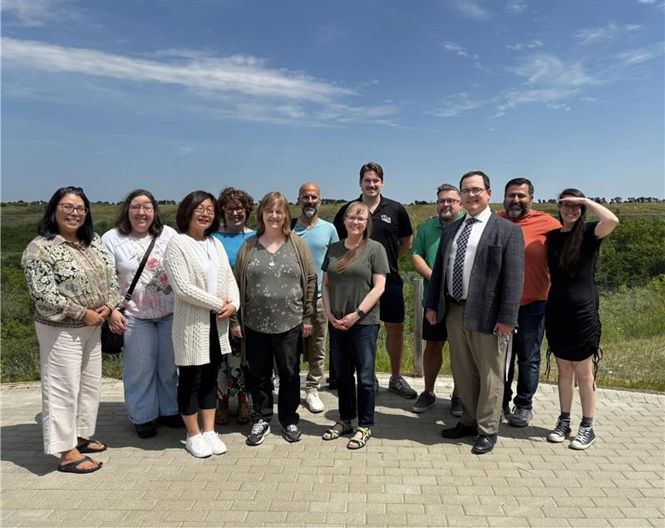
The ASPA EXECUTIVE
The ASPA Executive is comprised of twelve (12) volunteer members, each elected to serve a three-year term.
From within its members, the Executive appoints a President, two (2) Vice-Presidents, and a Treasurer, each serving a one-year term.
The Executive is responsible for:
Establishing and guiding the strategic direction of ASPA.
Supporting the implementation of ASPA’s strategic priorities through active participation in ASPA committees and initiatives.
Providing leadership and support to strengthen member engagement and participation.
Encouraging and creating opportunities for general members to become more involved with their union.
Representing the interests of ASPA members and advancing the priorities of the association.
Notes:
Highlight: the presidents and treasurer are elected from the executive board - that's how school trustees work (the chair is not elected, the trustees elect from themselves)

Slide 8
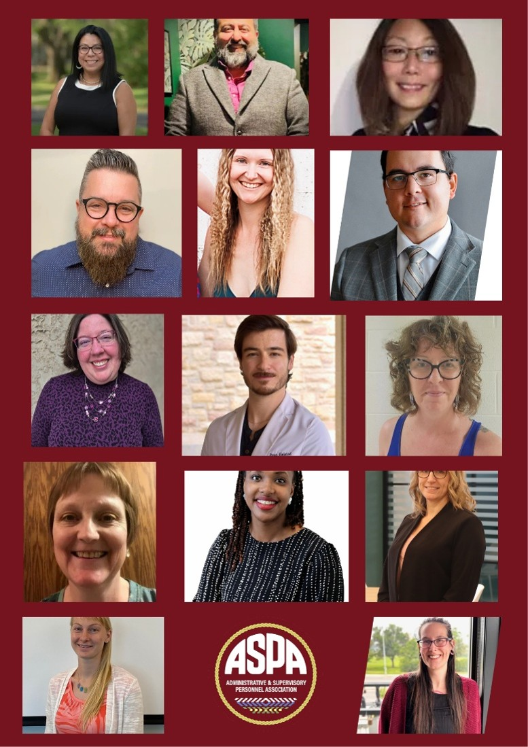
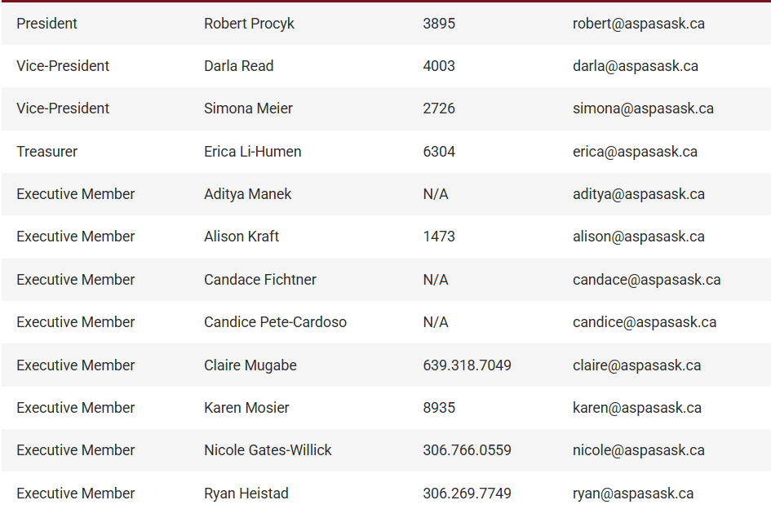
Meet the 2026-2027 ASPA Executives and staff
Notes:
From top, left to right, Candice Pete-Cardoso, Aditya Manek, Erica Li-Humen (Treasurer), Robert Procyk (ASPA President), Nicole Gates-Willick (Regina campus), Shayne Meggs (Staff), Simona Meier (Vice President), Ryan Heistad, Darla Read (Vice President), Karen Mosier, Claire Mugabe (Treasurer in Training), Alison Kraft, Candace Fitchner, and Angeline Hainstock (Staff).

Slide 9
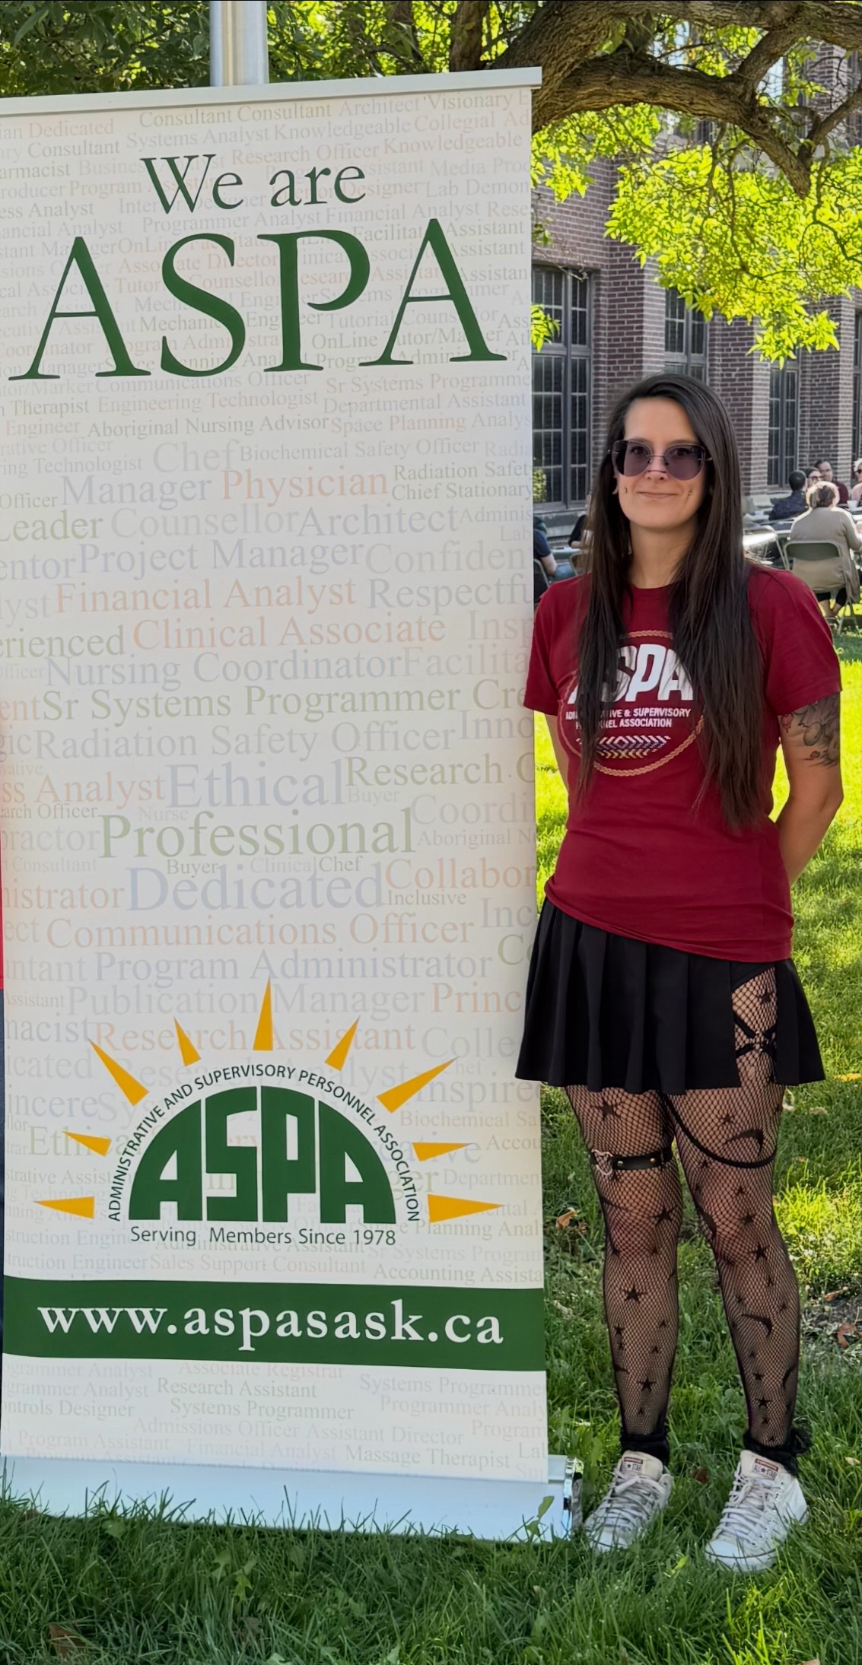
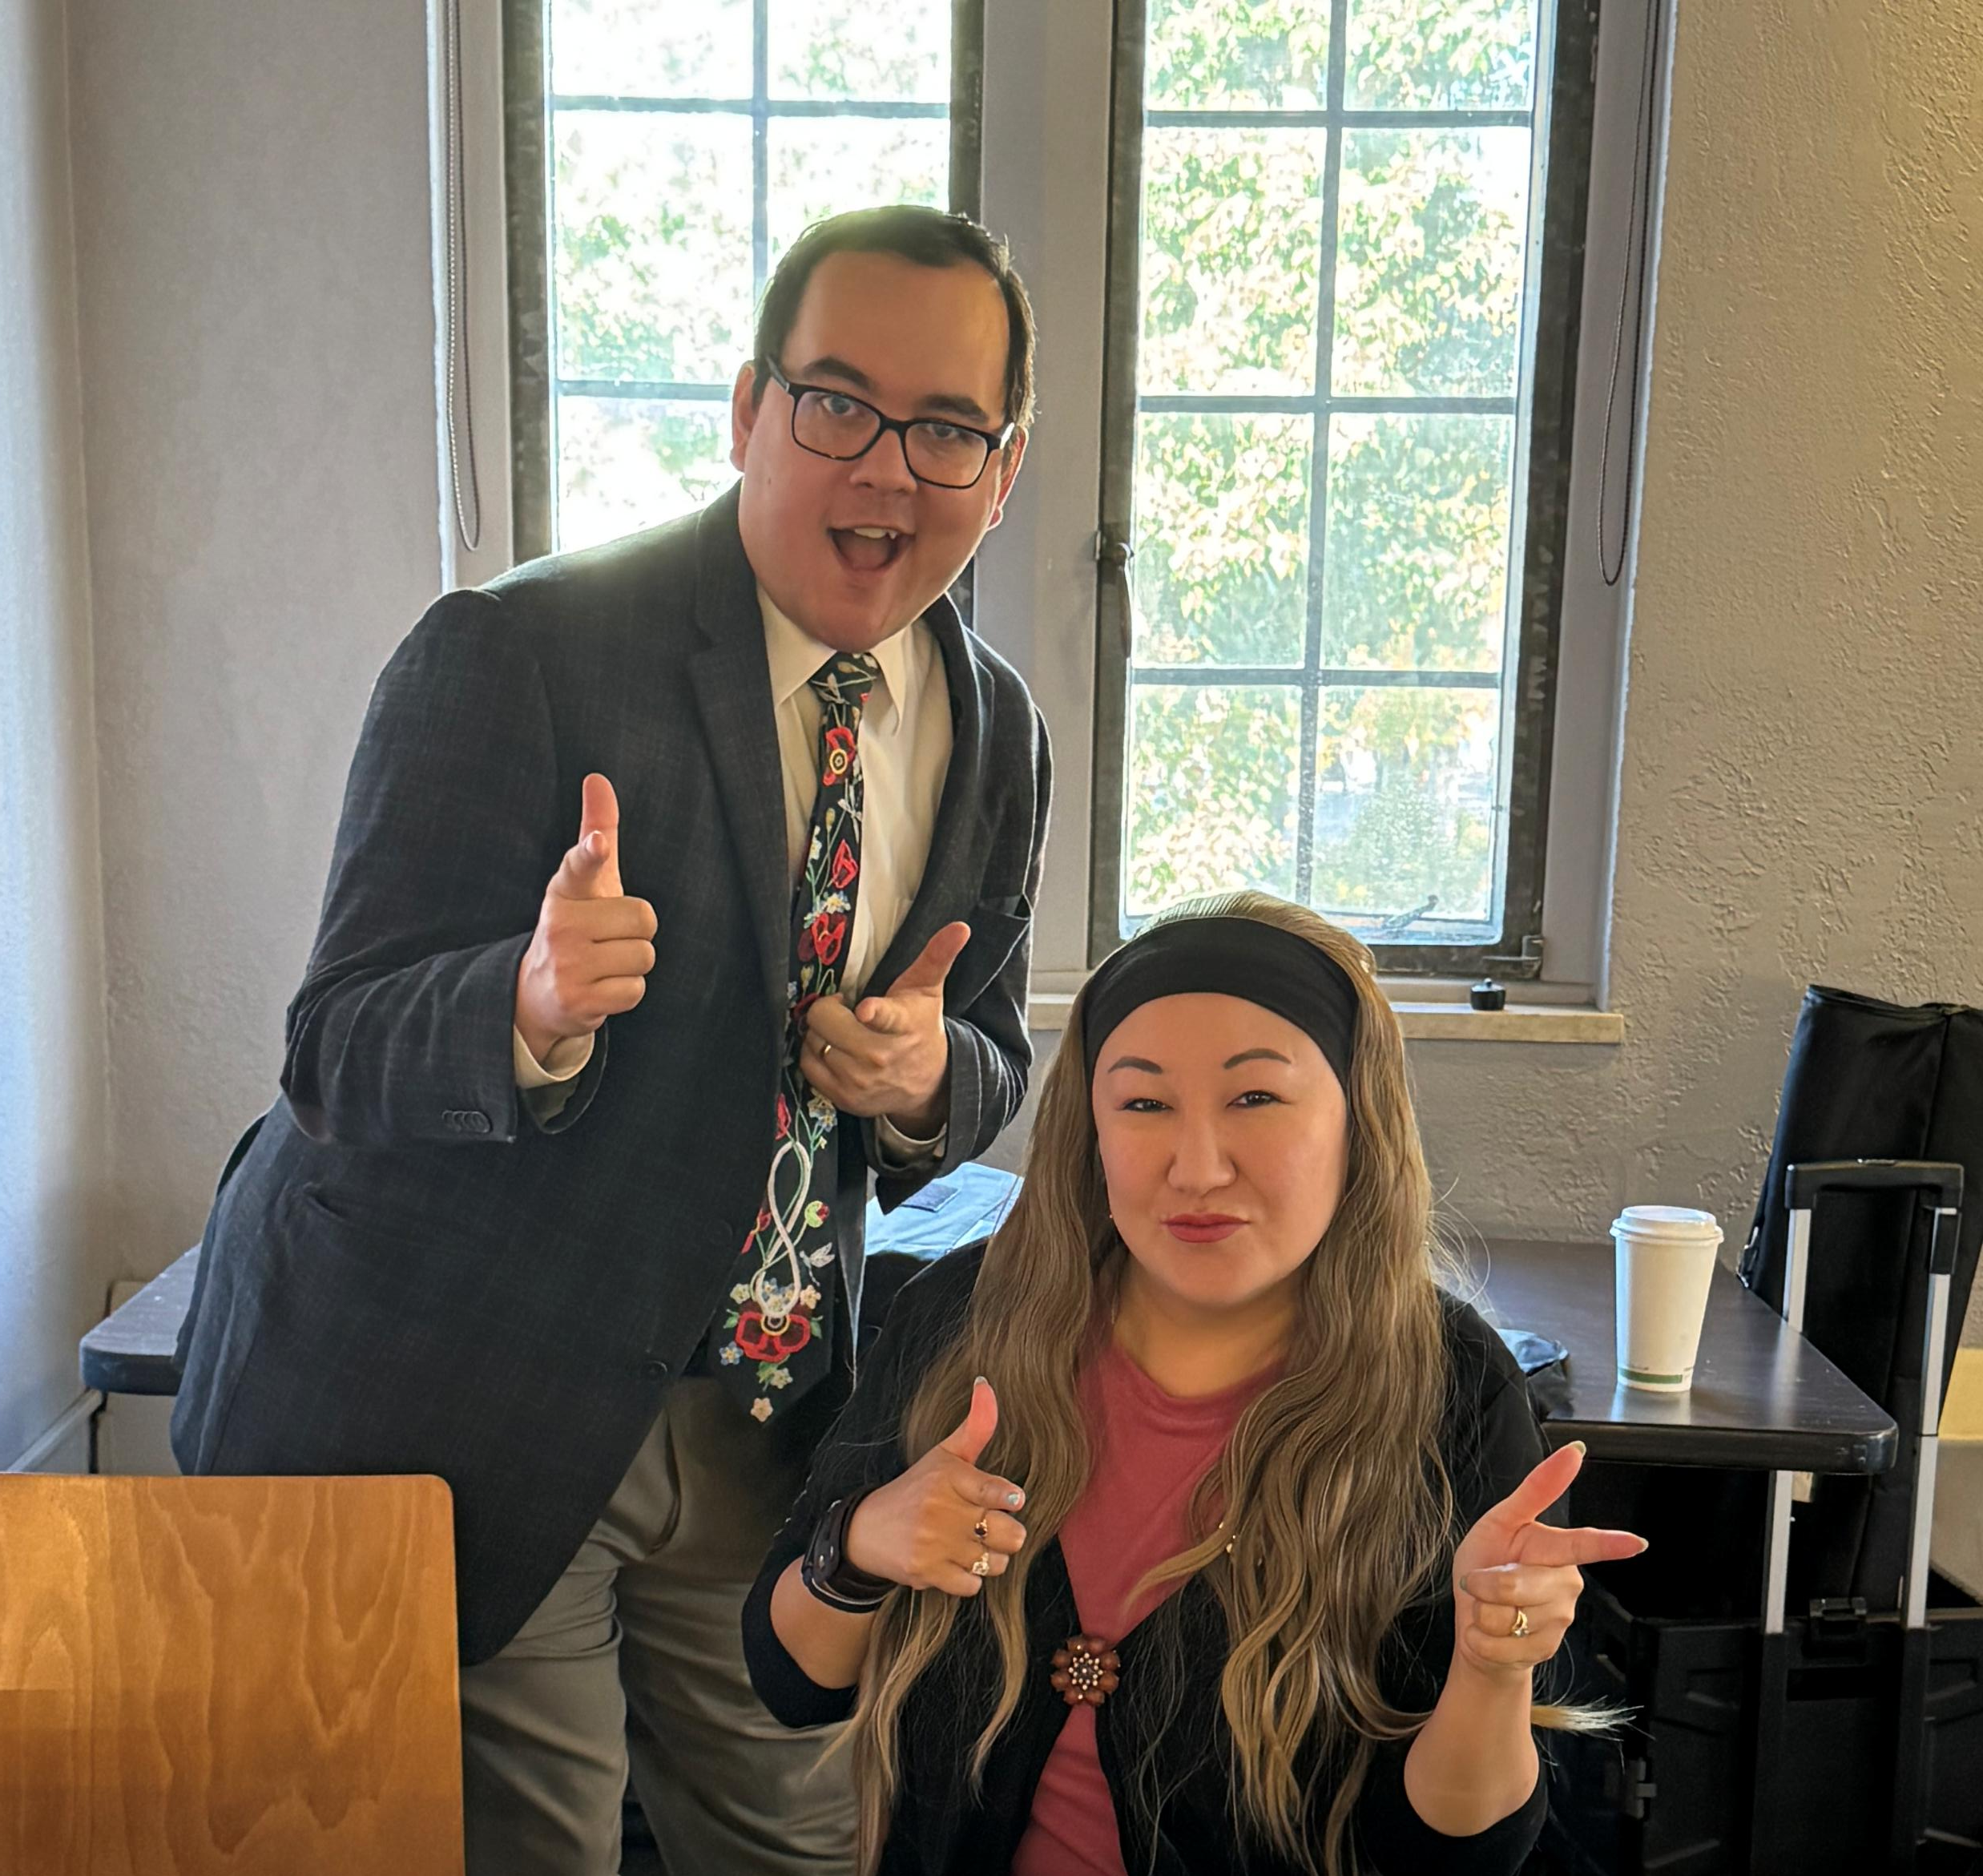
ASPA Staff
ASPA employs two (2) staff members to assist with providing member services and day-to-day operations:
Member Services Officer,
Shayne Meggs
Financial and Administrative Assistant, Angeline Hainstock
Notes:
MSO: Looks over members services and LR for the organization and provide overall union governance support
FAA: provides financial, administrative, operational, and governance support
These are your place of first contact. Shayne does most of the talking to the employer on a members' behalf

Slide 10
Work of the ASPA Executive

Slide 11
Meeting timeframes
The Executive meets once a month, with meetings held in person and a Zoom option available for those unable to attend in person.
Meetings are currently scheduled for approximately three hours, presently from 9 am to 12 noon.
The schedule for monthly meetings will be discussed and confirmed at the first Executive meeting in May.
Executive members may also participate in additional ASPA committees, alongside general member volunteers, based on their interest, availability, and capacity.
Ideally, each ASPA committee will have an Executive member serving as the chair or lead to provide leadership and maintain communication with the Executive.
Volunteer Hours
Executive members typically carry out their ASPA volunteer responsibilities during regular work hours.
The Collective Agreement recognizes ASPA members’ ability to participate in ASPA business during work time (Article 5.4). Executive members are not required to make up or compensate for this volunteer time by working additional hours.
The amount of time required varies depending on the Executive member’s role, responsibilities, and the ASPA committees or activities they choose to participate in.
Notes:
Work release for Presidents
Helping with case files when Shayne was on holidays
Try to have elected member present at meetings, whether they are a first point of contact, disciplinary, and certainly layoffs

Slide 12
ASPA Committees

Slide 13
Standing Committees
Engagement Committee
The Engagement Committee supports member engagement and participation across ASPA. The committee includes three interconnected sub-committees, with overlapping roles and responsibilities:
Sub-committee | Role
Communications & Public Relations Sub-Committee | Oversees the ASPA website and newsletter. The Committee is consulted on all communication to the membership and creates a newsletter four times a year.
Education Sub-Committee | Ensures the educational and professional development opportunities for our ASPA members, pertaining to any union related opportunities, are being advertised to the membership and utilized to the full advantage.
Social Sub-Committee | Plans events such as the pizza part of the Lunch and Learn sessions ASPA hosts, or the Winter and AGM social that happen each year

Slide 14
Standing Committees (Cont.)
Research Committee
Gathers information, feedback, and issues from ASPA members.
Develops and distributes member surveys throughout the year on bargaining and other issues requiring member input.
Provides research and member feedback to support the Executive and committees.
AI, Data, Algorithms & Automation Sub-Committee
Monitors developments in AI, automation, data, algorithms, and digital technologies that may affect ASPA members.
Identifies workplace rights and protections related to emerging technologies.
Provides advice and recommendations to the ASPA Executive.
Researches best practices from other unions and organizations.

Slide 15
Standing Committees (Cont.)
Nominations Committee
Supports the nomination and election process leading up to the AGM.
Oversees election documentation, online voting, and nominations for open Executive positions.
Encourages members to participate in the election process
Mentorship Program
initiative designed to foster professional growth and development
connect and share knowledge with ASPA members in various stages of their careers
to build meaningful professional relationships
networking and expanding your career
boosting employees well being and provide guidance in managing professional and personal priorities
Notes:
Contact Angeline

Slide 16
Other Committees
University Committees
ASPA maintains representation on the following university committees, which bring together union members and employer representatives:
Jurisdictional and New Positions Review
Joint Management and ASPA Appeals Committee (JMAAC)
Pensions
ASPA maintains representation on the following pension committees:
  Academic Defined Benefit Pension Plan Committee
  Academic Money Purchase Plan Committee
Other Committees and Teams
Additional committees and teams may be established as needed to address specific priorities or issues, such as, Strike Manual Committee, Merit Audit Team and Bargaining Team

Slide 17
Joining the ASPA Executive

Slide 18

Benefits
Have a voice: Help shape ASPA’s strategic direction and priorities.
Gain broader perspective: Learn more about what happens across campus beyond your own department or unit.
Make a difference: Be part of positive change and help support ASPA members.
Build your network: Connect with colleagues across the university and expand your professional network.
Develop new skills: Gain experience and build skills in areas that interest you.
Invest in your professional development: Access the ASPA Executive Professional Development Grant of up to $1,100 annually, in addition to your APEF.
Access additional training: Receive funding for union-related professional development opportunities.
Give back: Make a meaningful contribution to the University community and the labour organization.
Notes:
Give my perspective based on these benefits.

Slide 19
Nominations and Election Process
Executive positions are open to all ASPA members, regardless of length of service at USask, employment status, work area, or campus location, including Saskatoon, Regina, and Prince Albert.
The Nominations Committee is established each November, with a Chair and administrative support responsible for coordinating the nomination and election process.
The call for nominations is typically sent to members in late January or early February.
Candidate information, including nominations, is posted on the ASPA website in March.
Members interested in serving on the Executive must be nominated through the official nomination form when the call for nominations is issued.
Candidates provide a short biography and photo for members to review before voting.
Voting is conducted electronically, with successful candidates announced at the Annual General Meeting.

Slide 20
Executive Member Expectations
Executive members are expected to:
Participate in at least 50% of Executive meetings.
Participate in or chair an ASPA committee/sub committee, as appropriate.
Be prepared to represent ASPA members at employer meetings, including matters such as layoffs and fact-finding processes. Training and support are provided.
Participate in ASPA social activities and events as Union Representatives.
Terms of Office
Following the election, new Executive members take their seats for the term associated with the vacant position. Terms range from one to three years, depending on the position.

Slide 21
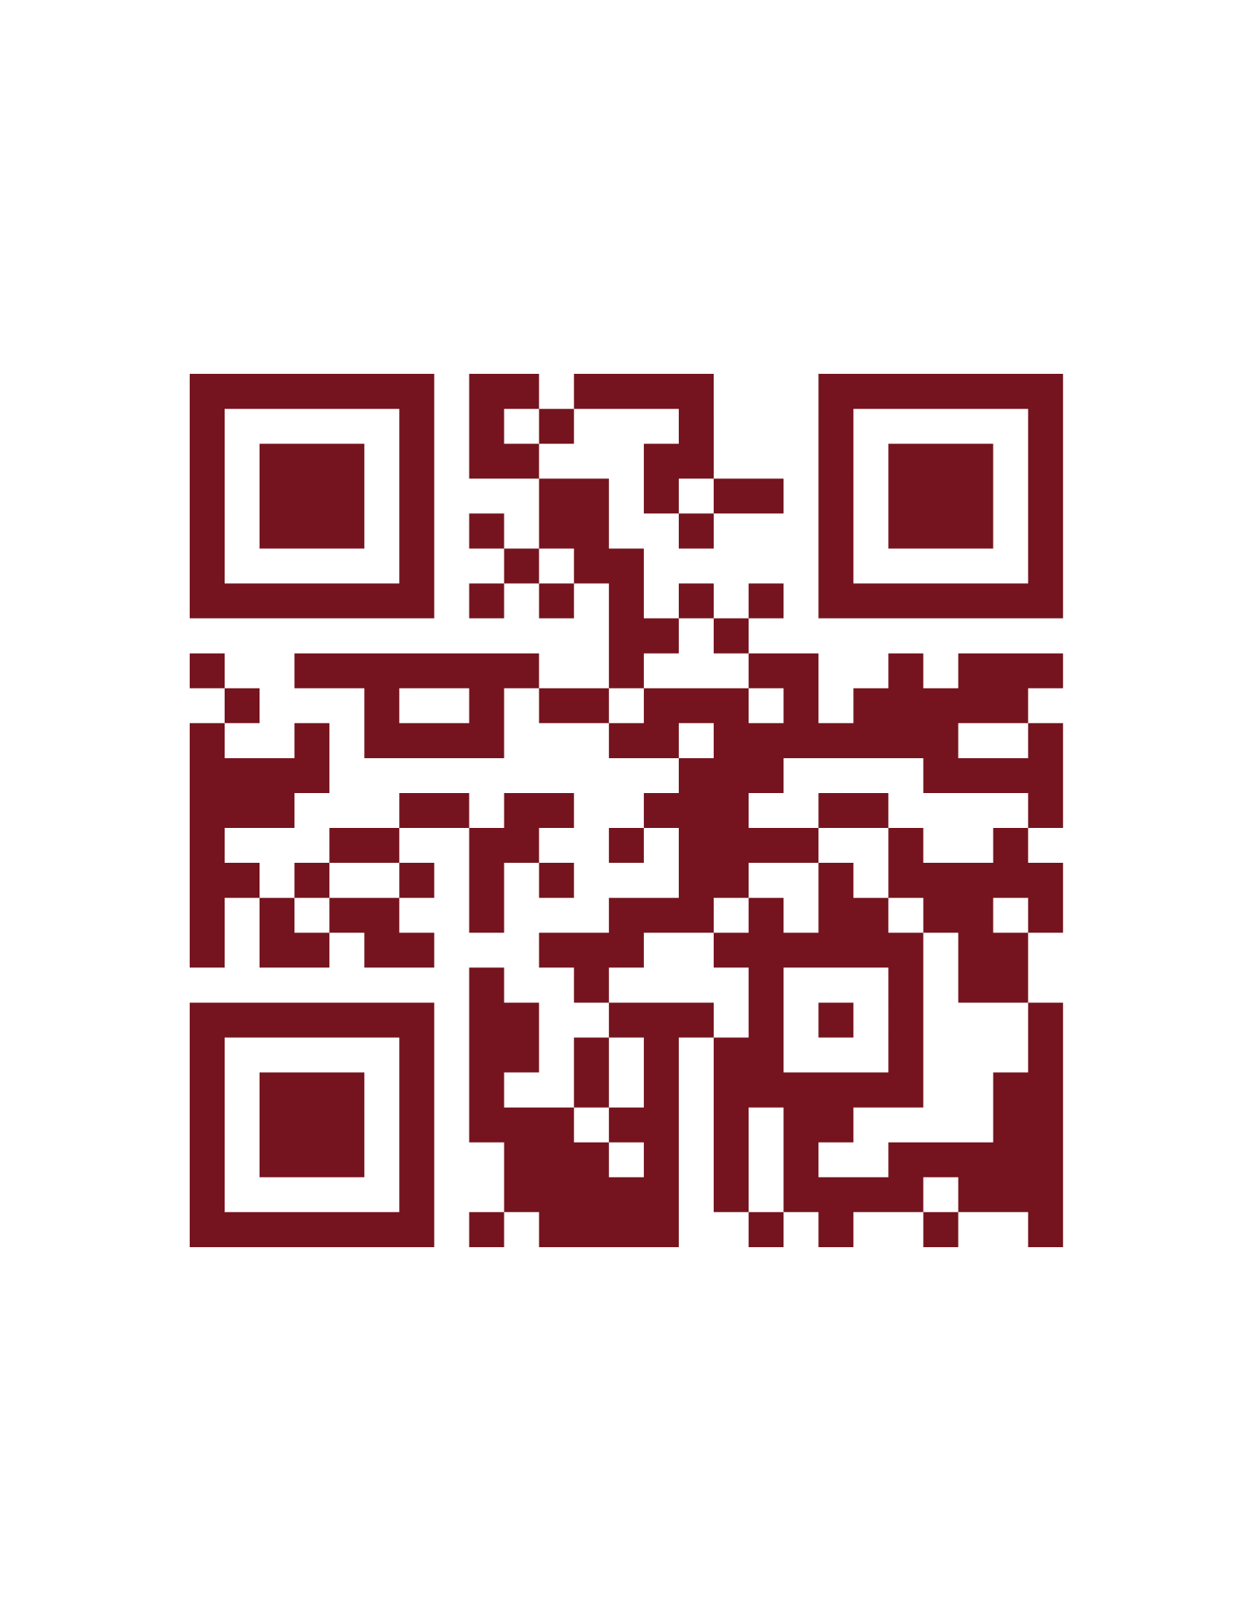
Learn more on the ASPA website by scanning the QR code or visiting the link below.
aspasask.ca/about-aspa/volunteering-in-aspa/

Slide 22
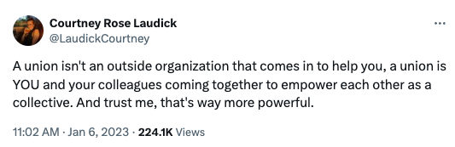
A parting quote to think about:

Slide 23
Thank you!
Upcoming ASPA Lunch & Learns
October – Bargaining Update
November – Work Life Balance
January – Grievances and the Process
February – What benefits are offered to ASPA
March – Facilities & non-union related
April – Merit Discussion
If interested in joining any committees or you have questions, contact us!
Angeline@aspasask.ca
Darla@aspasask.ca
aspasask.ca

